Slide 1
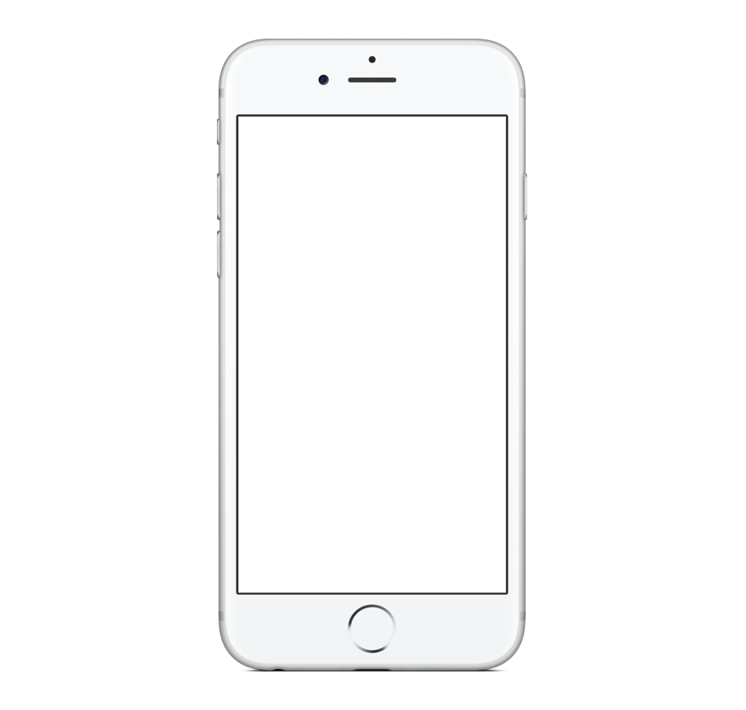
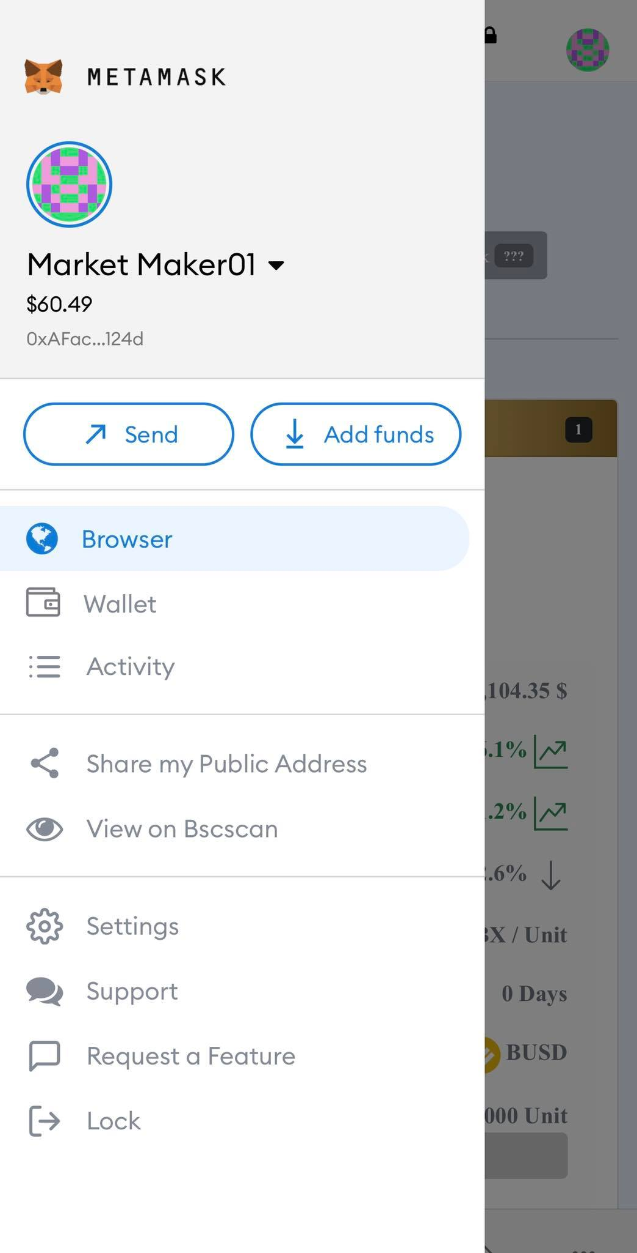
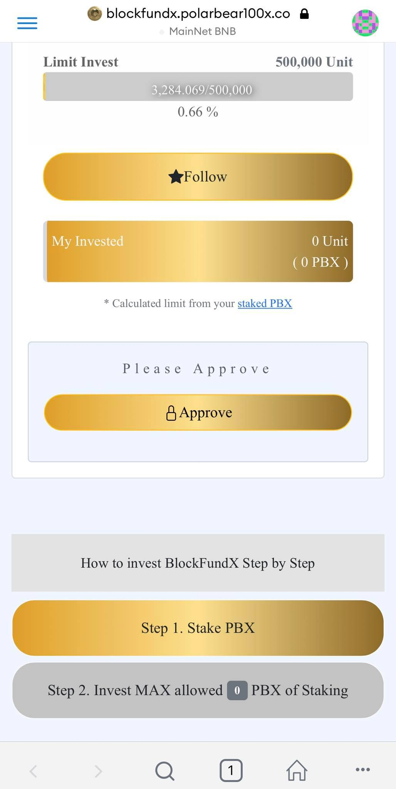
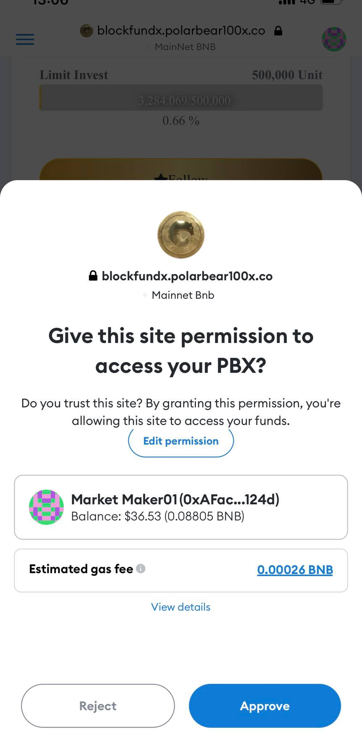
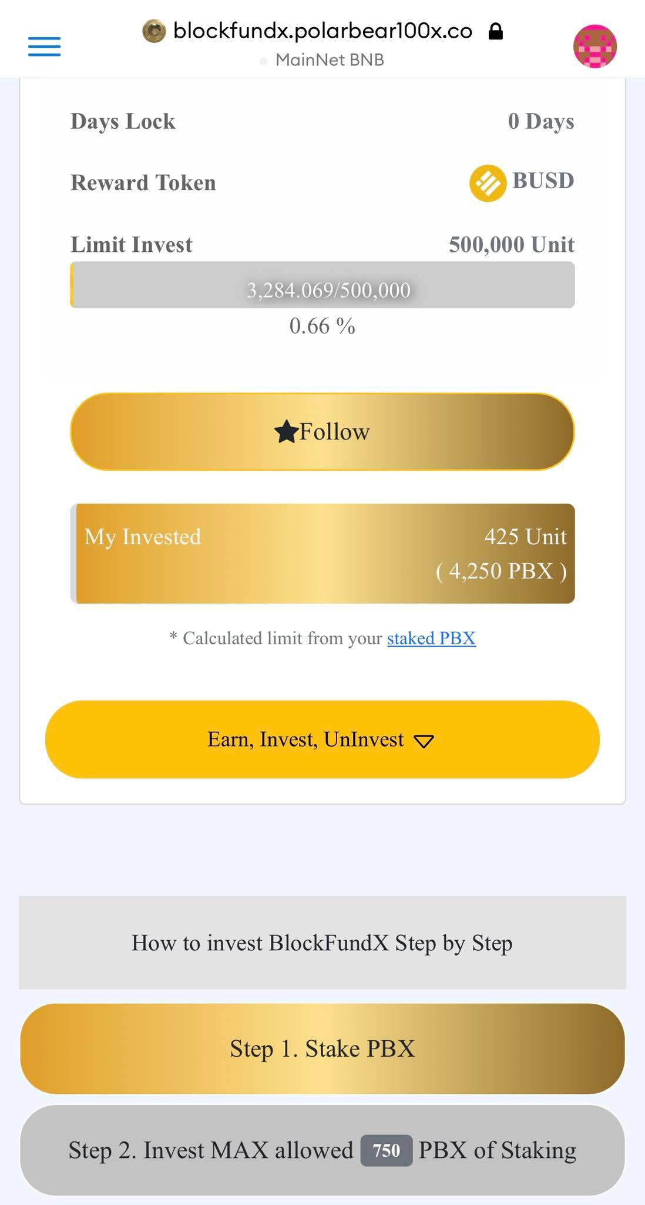
STEP 0 : Approve BlockFundX
PBX
1 0 0 X
Go to Browser : https://blockfundx.polarbear100x.co/
Connect : Metamask wallet
Connected Metamask : Approve
Earn, Invest, Uninvest
Please Approve : Approve
***Transaction fee (BNB) based on Metamask wallet
Step 1. Stake PBX first
Step 2. Invest MAX allowed PBX

Slide 2
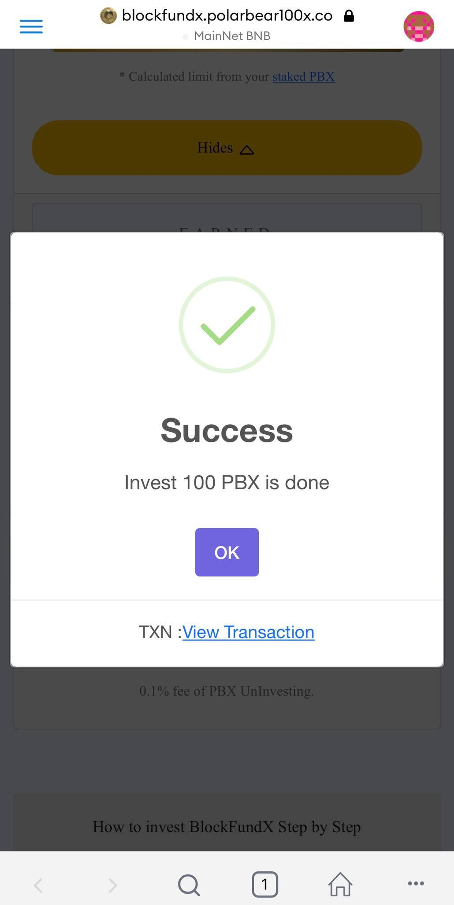
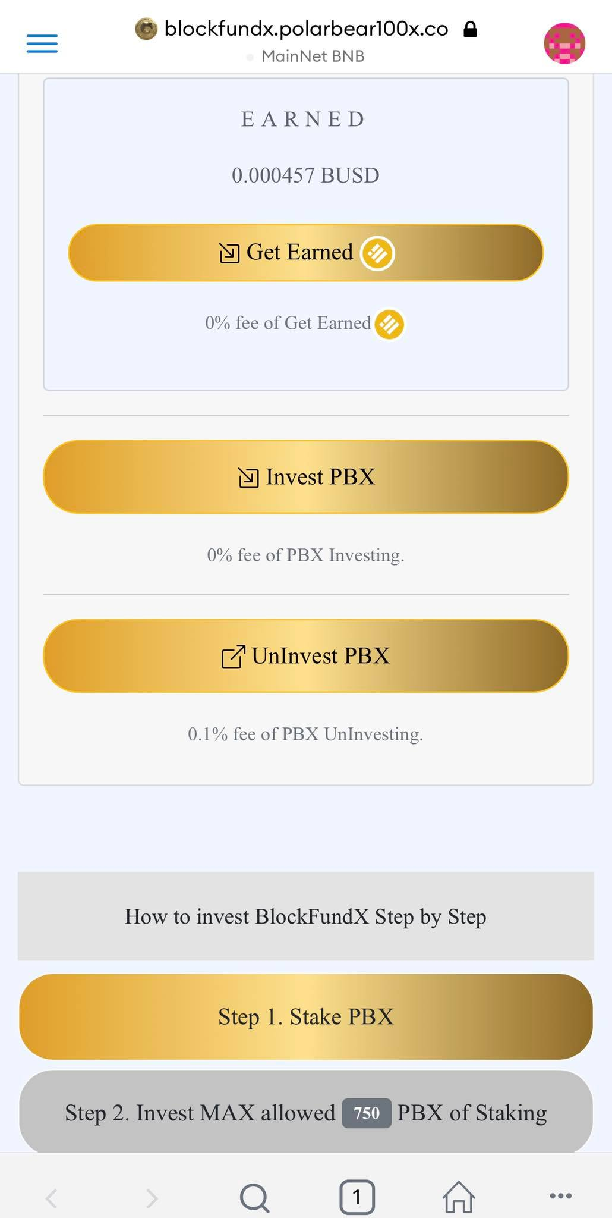
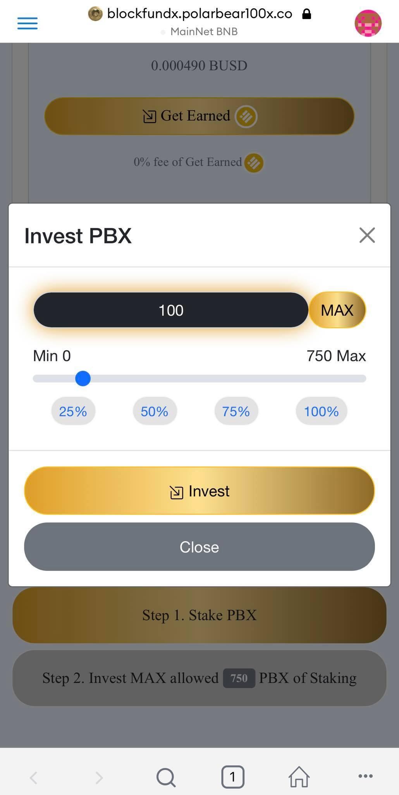
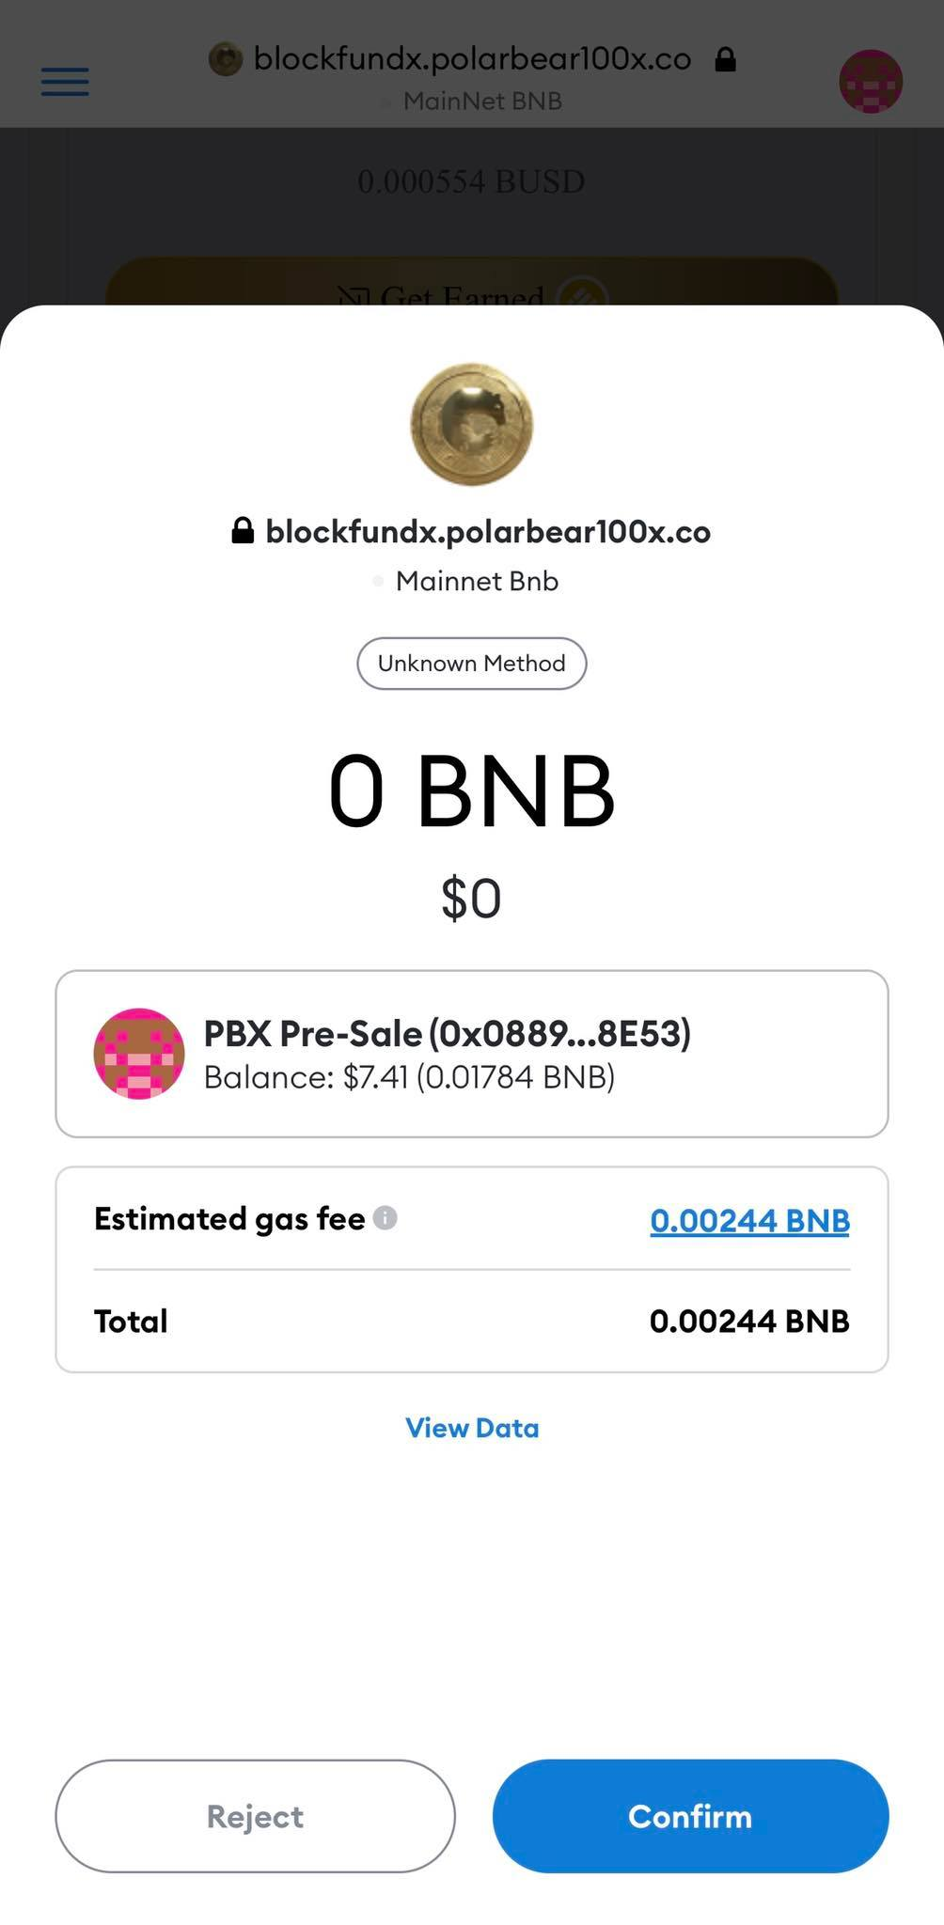
STEP 1 : Invest PBX : https://blockfundx.polarbear100x.co
PBX
1 0 0 X
Connected Metamask : Press Invest PBX
Invest PBX : Select amount of PBX
Press Confirm
Success Invested PBX
Press Invest button
***Gas fee (BNB) based on Metamask wallet

Slide 3
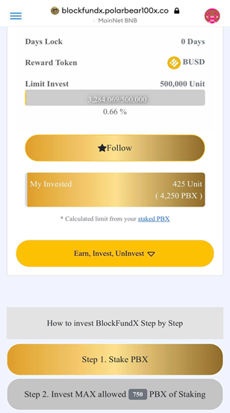
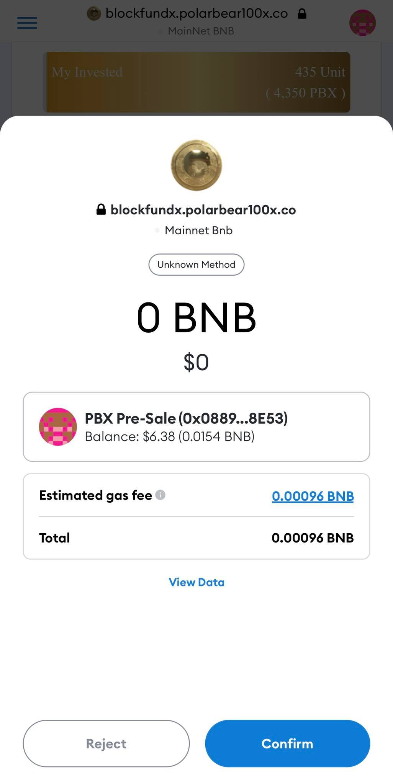
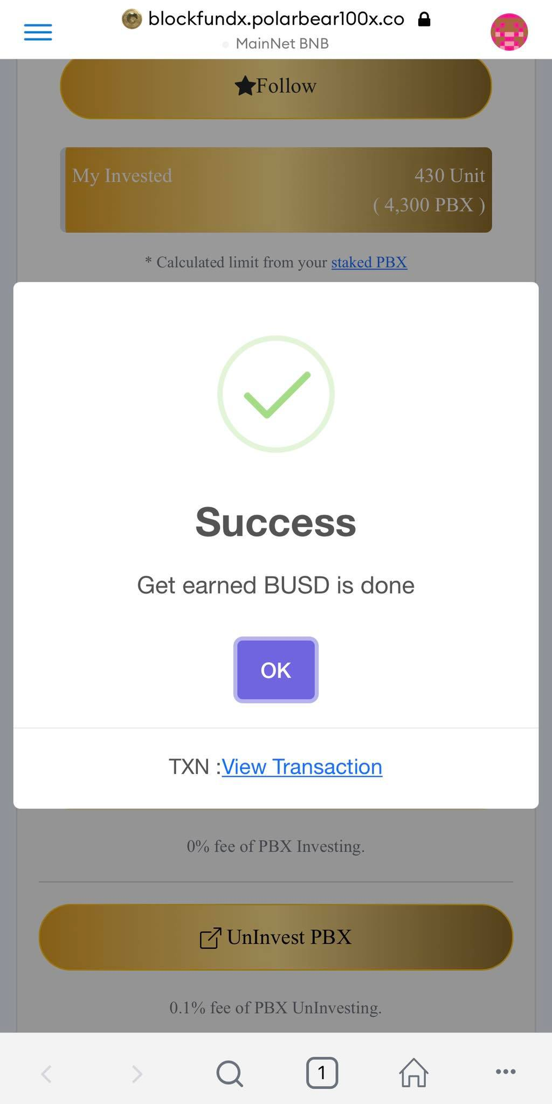
STEP 2 : Get Earned BUSD : https://blockfundx.polarbear100x.co
PBX
1 0 0 X
Press Confirm
Success Get Earned BUSD
Connected Metamask : Earn, Invest, Uninvest
Invest PBX : Press Get Earned
Press Invest button
***To see BUSD, Don’t forget to add Token on Metamask wallet

Slide 4
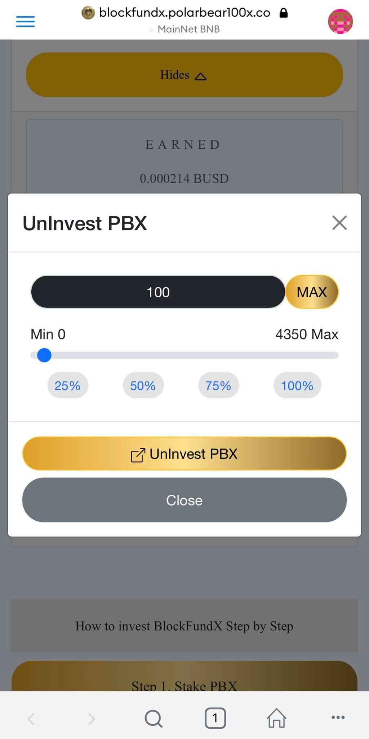
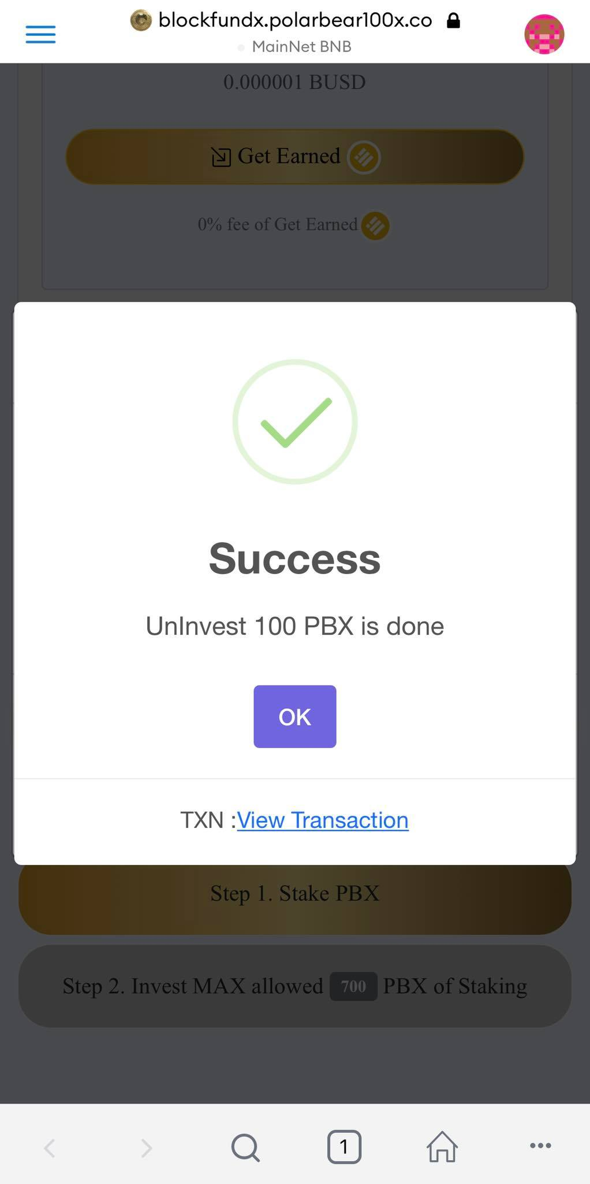
STEP 3 : UnInvest PBX : https://blockfundx.polarbear100x.co
Connected Metamask : Press UnInvest PBX
UnInvest PBX : Select amount of PBX
Press Confirm
Success UnInvested PBX
Press UnInvest button
***Gas fee (BNB) based on Metamask wallet
*** Earned BUSD transferred automatically to Matamask wallet
*** To see BUSD, Don’t forget to add Token on Metamask wallet

